Slide 1
Concepts of Machine Learning and Linear Regression

Slide 2
Learning Objectives
Introduction to Machine Learning and its importance
Machine Learning happens in Mathematical space
Supervised Machine Learning
Linear Regression and Pearson’s Coefficient
Best fit line and Coefficient of Determinant
Pros and Cons of Linear Regression
Case Study
‹#›

Slide 3
Introduction to Machine Learning
The ability to do the tasks come from the underlying model which is the result of the learning process.
The model is generated from huge volume of data, huge both in breadth and depth reflecting the real world in which the processes are performed.
What machine learning algorithms do?
Search through the data to look for patterns in form of trends, cycles, associations, etc.
Express these patterns as mathematical structures such as probability or polynomial equations.

Slide 4
Industry use cases of Machine Learning
Sow
Simpler use cases
Complex use cases
Predict if a customer will default a loan
What is the probability that an employee will quit his job?
What are the factors that influence customer churn?
What is the predicted sales for a product for this year?
Detect audience sentiment for a new movie
Used for character recognition or natural language processing.
Too complex and dynamic, eg: Weather Forecasting.
Patterns hidden in humongous data, eg: Recommendation System
Too many permutations and combinations possible , eg: Genetic Code mapping
And much more!!

Slide 5
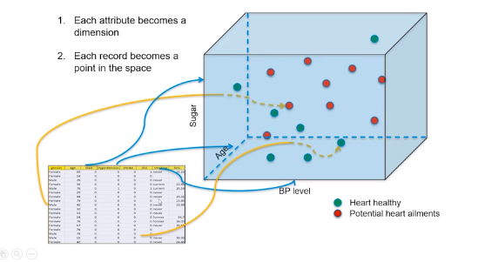
Machine Learning happens in Mathematical space
A data representing the real world, is a collection attributes that define an entity.

Slide 6
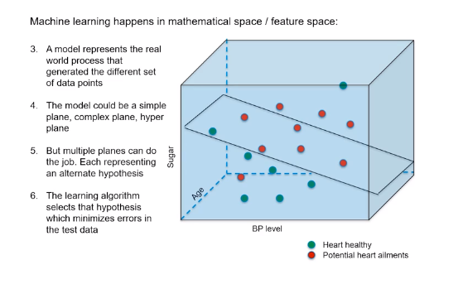
Machine Learning happens in Mathematical space

Slide 7
Supervised vs unsupervised learning
Sow
Supervised learning
Unsupervised learning
Clearly defined X and Y variables
Predict a continuous response (Regression)
categorical response (classification)
Unlabelled data
Emerging patterns based on similarity identified
Clustering
Association rules (market basket analysis)

Slide 8
Supervised Machine Learning
Class of machine learning that work on externally supplied instances in form of predictor attributes and associated target values.
The model thus generated is used to make predictions about future instances.
Eg: building model to predict the resale value of a car based on its mileage, age, colour etc
Supervised learning problems can be further grouped into regression and classification problems.

Slide 9
Data Science Machine Learning Steps:
Identify data required
Pre-process Data
Create training & test set
Select appropriate algorithm’s
Train and build the model
Evaluate with test data

Slide 10
Classification vs regression
Sow
Regression
X variable – numerical or categorical
Y variable - numerical
Predictive modeling
Classification
X variable – numerical or categorical
Y variable - categorical

Slide 11
Linear Regression
The term “Regression” generally refers to predicting a real number.
The term “linear” in linear regression refers to the fact that the method models data with linear combination of the explanatory variables.
In case of linear regression with a single explanatory variable, the linear combination can be expressed as :
response = intercept + constant + explanatory

Slide 12
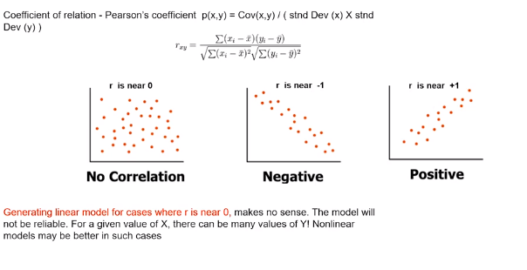
Pearson’s Coefficient

Slide 13
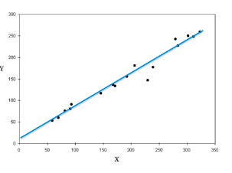
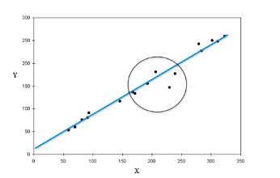
Best fit line
Given Y = f(x) and the scatter plot shows apparent correlation between X and Y.
But there are infinite number of lines that can be fit in the scatter.
The distance between a point and the line is the error in prediction.

Slide 14
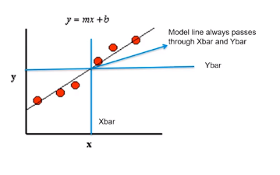
Coefficient of Determinant
Coefficient of determinant determines the fitness of a linear model. The closer the points get to the line, the R² (coeff of determinant) tends to 1, the better the model is.

Slide 15
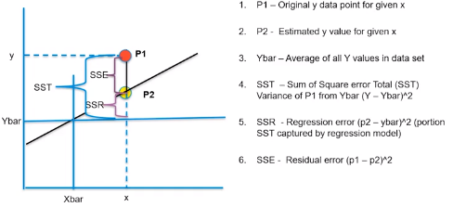
SSE and SSR

Slide 16
Pros and Cons of Linear Regression
Advantages
Simple to implement and easier to interpret the outputs coefficient.
Disadvantages
Assumes a linear relationships between dependent and independent variables.
Outliers can have huge effects on regression.
Linear Regression assume independence between attributes.

Slide 17
Case Study
Context:
A marketer is interested in the effect of changing shelf height (x1) and shelf width (x2) on the weekly sales (y) of her brand of laundry detergent in a grocery store.
Objective:
We have at least one variable that is known (in some cases it is controllable), and a response variable that is a random variable. We would like to fit a model that relates the response to the known or controllable variable(s).

Slide 18
that the more shelf space their product takes up, the higher the frequency of such purchases
in the range of 3 to 9 feet, the mean weekly sales will be linearly related to the width of the shelf space
fit a model relating weekly sales y to the amount of shelf space x her product receives that week

Slide 19
Case study: Linear regression
Equation:
y = β0 + β1x + ε, so that y|x ∼ N(β0 + β1x, σ).
Steps:
Compute estimates of the parameters β0 and β1.
Take a sample of n subjects, observing values y of the response variable and x of the predictor variable.
Choose as estimates for β0 and β1, the values b0 and b1 that ‘best fit’ the sample data.

Slide 20
Case study: Linear regression
Some formulas to follow :
SSxx = Σ (x – x̅) ² = Σ x² − ( Σ x)² /n
SSxy = Σ (x − x̅)(y − ȳ) = Σ xy − ( Σ x)( Σ y) /n
SSyy = Σ (y − ȳ) ² = Σ y² − ( Σ y)² /n
Obtain the least squares estimate of the true linear regression relation (β0+β1x)
b1 = SSxy /SSxx , b0 = Σ y /n − b1 Σ x /n, yˆ = b0 + b1x

Slide 21
Real life applications of regression
Sow
Predict health insurance claim for a customer based on demographic & health attributes
Predict annual income of a person based on demography, skill area and work experience information
Predict travel time based on traffic, location and time related attributes

Slide 22


Questions?

